Slide 1

Automatic Goal Generation for Reinforcement Learning Agents
Carlos Florensa, David Held, Xinyang Geng, Pieter Abbeel
Alessandro Sardelli 561158

Slide 2
Introduction to the problem:
Reinforcement learning is a powerful technique to train an agent to perform a task, however, an agent that is trained using RL is only capable of achieving the single task that is specified via its reward function. Such an approach does not scale well to settings in which an agent needs to perform a diverse set of tasks, such as navigating to varying positions in a room or moving objects to varying locations. Instead, Carlos Florensa, et al. propose a method that allows an agent to automatically discover the range of tasks that it can perform in its environment using a generative adversarial network.

Slide 3
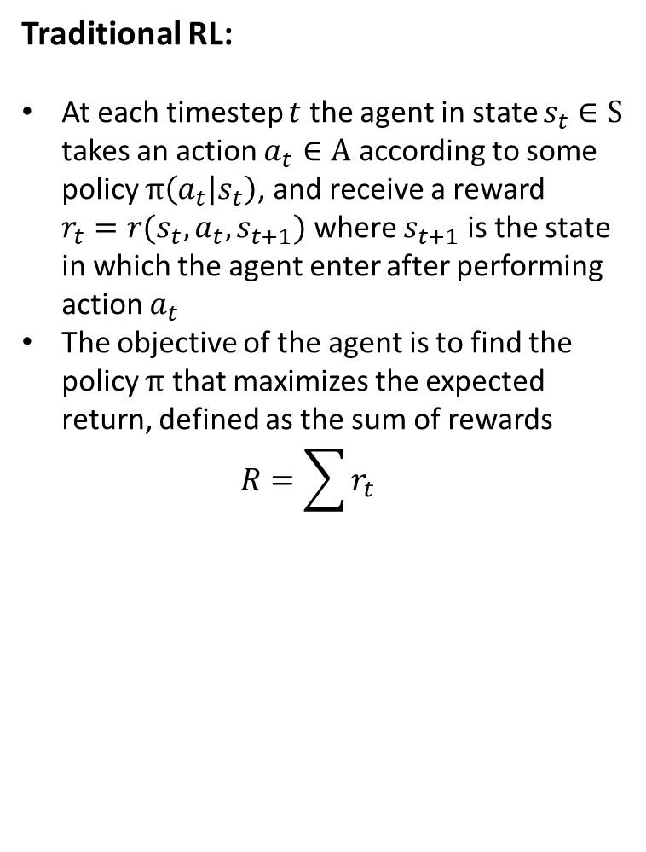
Traditional RL:
At each timestep $t$ the agent in state $s_{t}∈S$ takes an action $a_{t}∈A$ according to some policy $π\left(a_{t} | s_{t}\right)$, and receive a reward $r_{t}=r(s_{t},a_{t},s_{t+1})$ where $s_{t+1}$is the state in which the agent enter after performing action $a_{t}$
The objective of the agent is to find the policy $π$ that maximizes the expected return, defined as the sum of rewards $R=\sum{r_{t}}$
RL with Automatic Goal Generation :
A goal discriminator is trained to evaluate whether a goal is at the appropriate level of difficulty for the current policy, and a goal generator is trained to generate goals that meet this criteria
Incrementally learn a policy that perform well on sets of goals iteratively generated based on the agent performances

Slide 4
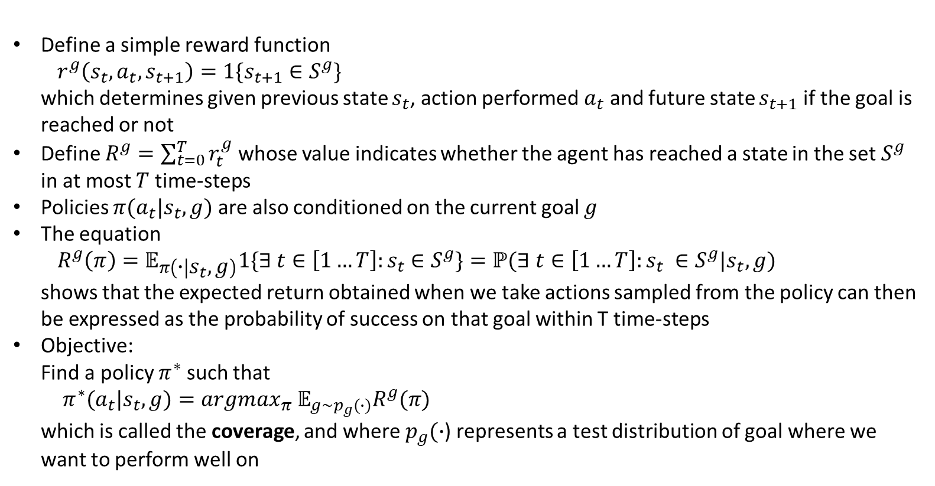
Problem Formalization:
Define a simple reward function $r^{g}\left(s_{t},a_{t},s_{t+1}\right)=1\{s_{t+1}∈S^{g}\}$ which determines given previous state $s_{t}$, action performed $a_{t}$ and future state $s_{t+1}$if the goal is reached or not
Define $R^{g}=\sum_{t=0}^{T}{r_{t}^{g}}$ whose value indicates whether the agent has reached a state in the set $S^{g}$ in at most $T$ time-steps
Policies $π(a_{t}|s_{t}, g)$are also conditioned on the current goal $g$
The equation $R^{g}\left(π\right)=𝔼_{π\left(∙ | s_{t},g\right)}1\{∃ t∈\left[1…T\right]:s_{t}$ $∈S^{g}\}=ℙ(∃ t∈\left[1…T\right]:s_{t} ∈S^{g}|s_{t},g)$ shows that the expected return obtained when we take actions sampled from the policy can then be expressed as the probability of success on that goal within T time-steps
Objective: Find a policy $π^{∗}$ such that $π^{∗}(a_{t}|s_{t},g)=argmax_{π}$ $𝔼_{g\sim p_{g}(∙)}R^{g}(π)$ which is called the coverage, and where $p_{g}(∙$) represents a test distribution of goal where we want to perform well on

Slide 5
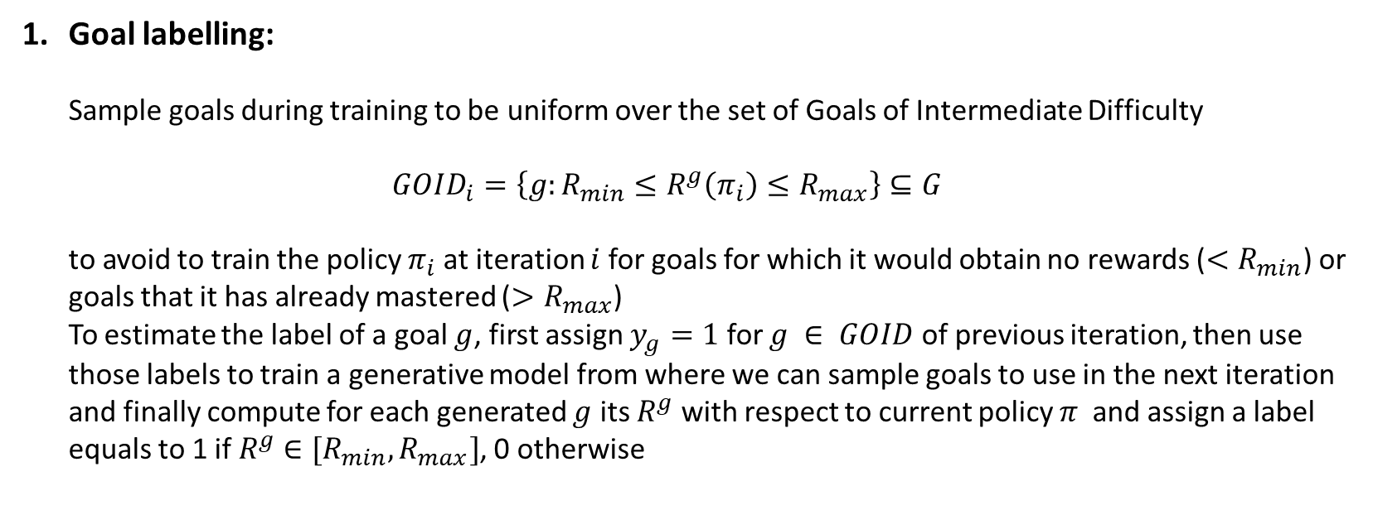
3-steps Method:
Goal labelling: Sample goals during training to be uniform over the set of Goals of Intermediate Difficulty $GOID_{i}=\left\{g:R_{min}≤R^{g}\left(π_{i}\right)≤R_{max}\right\}⊆G$ to avoid to train the policy $π_{i}$ at iteration $i$ for goals for which it would obtain no rewards ($<R_{min}$) or goals that it has already mastered (${>R}_{max}$) To estimate the label of a goal $g$, first assign $y_{g}=1$ for $g ∈ GOID$ of previous iteration, then use those labels to train a generative model from where we can sample goals to use in the next iteration and finally compute for each generated $g$ its $R^{g}$ with respect to current policy $π$ and assign a label equals to 1 if $R^{g}$ $∈[R_{min},R_{max}]$, 0 otherwise

Slide 6
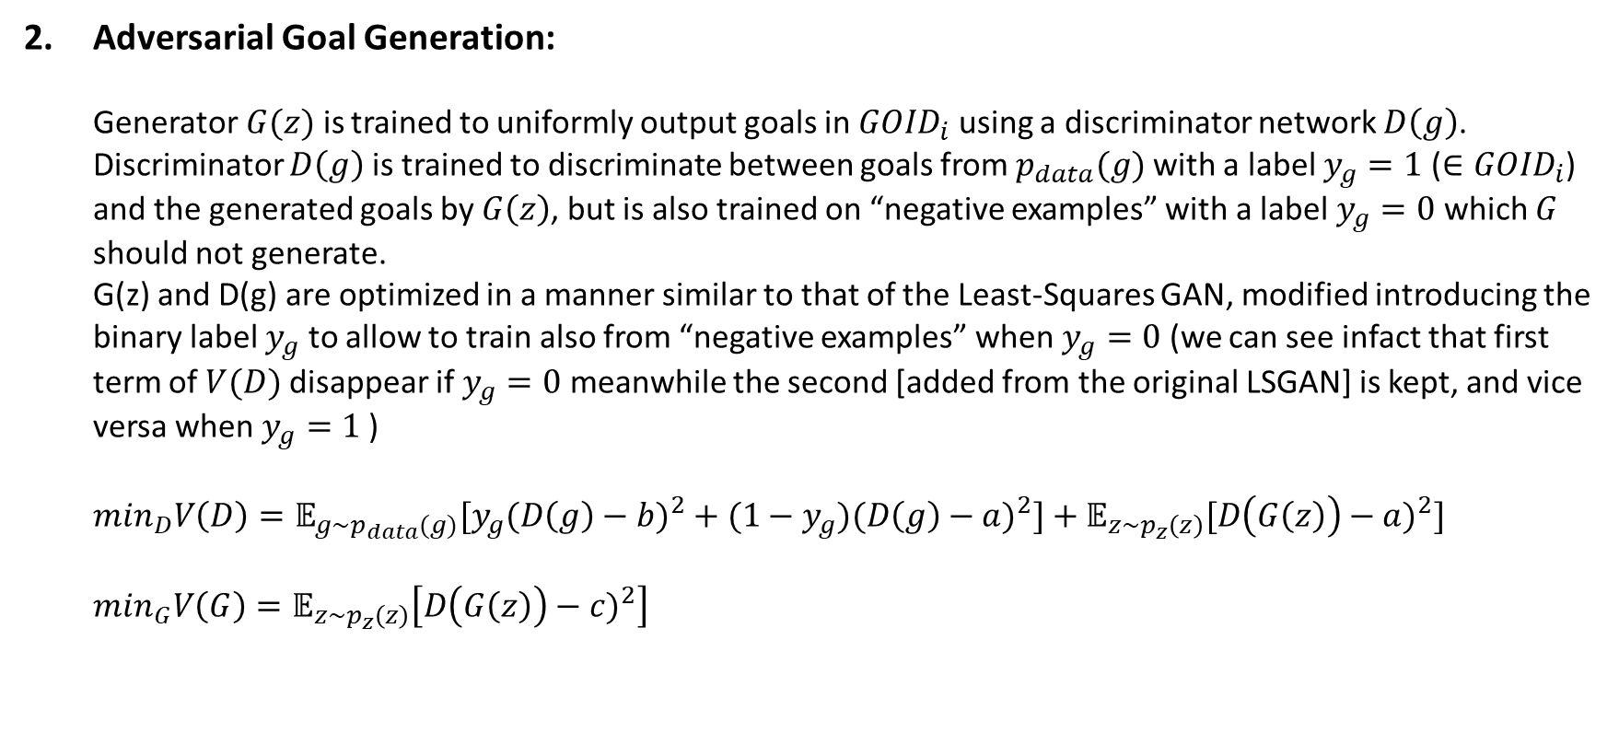
Adversarial Goal Generation: Generator$G(z)$is trained to uniformly output goals in $GOID_{i}$ using a discriminator network $D\left(g\right)$. Discriminator $D\left(g\right)$is trained to discriminate between goals from $p_{data}(g)$with a label $y_{g}=1$ ($∈GOID_{i}$) and the generated goals by $G\left(z\right)$, but is also trained on “negative examples” with a label $y_{g}=0$ which $G$ should not generate. G(z) and D(g) are optimized in a manner similar to that of the Least-Squares GAN, modified introducing the binary label $y_{g}$ to allow to train also from “negative examples” when $y_{g}=0$ (we can see infact that first term of $V(D)$disappear if $y_{g}=0$ meanwhile the second [added from the original LSGAN] is kept, and vice versa when$y_{g}=1$ ) $\min_{D}V\left(D\right)=𝔼_{g\sim p_{data}(g)}[y_{g}(D\left(g\right)−b)^{2}+(1−y_{g})(D\left(g\right)−a)^{2}]+𝔼_{z\sim p_{z}\left(z\right)}[D\left(G\left(z\right)\right)−a)^{2}]$ $\min_{G}V\left(G\right)=𝔼_{z\sim p_{z}\left(z\right)}\left[D\left(G\left(z\right)\right)−c)^{2}\right]$

Slide 7
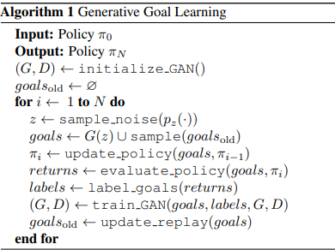
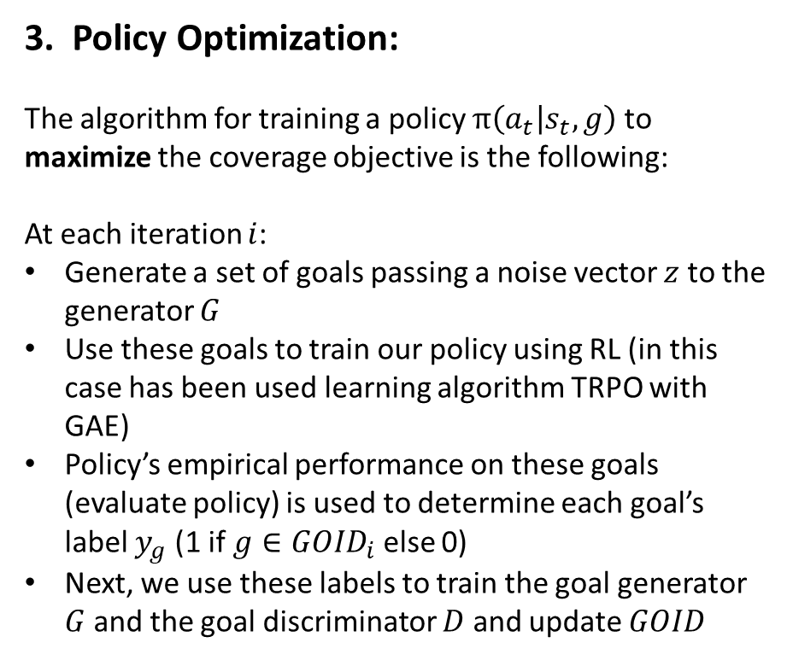
Policy Optimization:
The algorithm for training a policy $π\left(a_{t} | s_{t},g\right)$ to maximize the coverage objective is the following:
At each iteration $i$:
Generate a set of goals passing a noise vector $z$ to the generator $G$
Use these goals to train our policy using RL (in this case has been used learning algorithm TRPO with GAE)
Policy’s empirical performance on these goals (evaluate policy) is used to determine each goal’s label $y_{g}$ (1 if $g∈{GOID}_{i}$ else 0)
Next, we use these labels to train the goal generator $G$ and the goal discriminator $D$ and update $GOID$

Slide 8
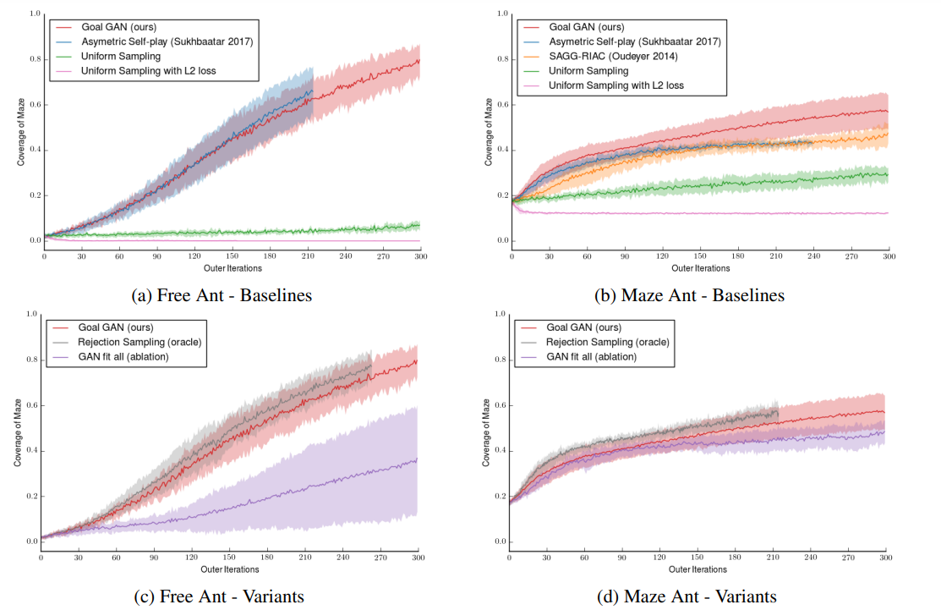
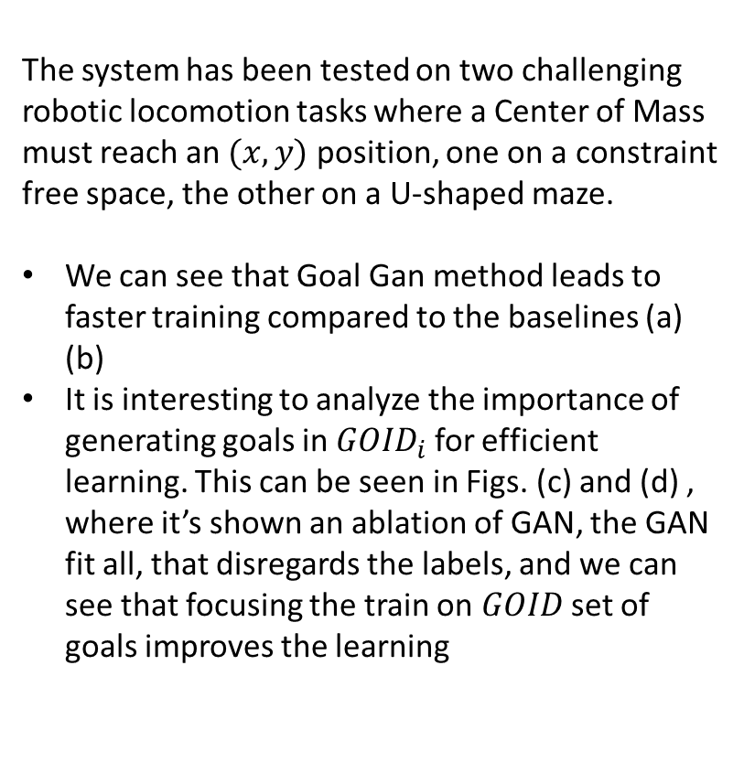
Experimental Results:
The system has been tested on two challenging robotic locomotion tasks where a Center of Mass must reach an $(x, y)$ position, one on a constraint free space, the other on a U-shaped maze.
We can see that Goal Gan method leads to faster training compared to the baselines (a) (b)
It is interesting to analyze the importance of generating goals in ${GOID}_{i}$ for efficient learning. This can be seen in Figs. (c) and (d) , where it’s shown an ablation of GAN, the GAN fit all, that disregards the labels, and we can see that focusing the train on $GOID$ set of goals improves the learning

Slide 9
Conclusion
This paper shows foundamental findings in the Reinforcement Learning field, which problem is that agents trained with this approach are only capable of achieving the single task that is specified via its reward function.
Carlos Florensa et al. presented a formal approach to generate automatically sets of tasks of increasing difficulty that dinamically adapt to the agent snapshot performance that ease his learning process.
Those curriculum are generated through a Generative Adversarial Network which were adapted to this problem, which Florensa et al. called Goal GAN.
Future works aim to combine Goal GAN with recent multi-goal approaches like HER, and again to build hierarchy on top of the multi-task policy by training a higher-level policy that outputs the goal for the lower-level multi-task policy.

Slide 10
Appendix

Slide 11
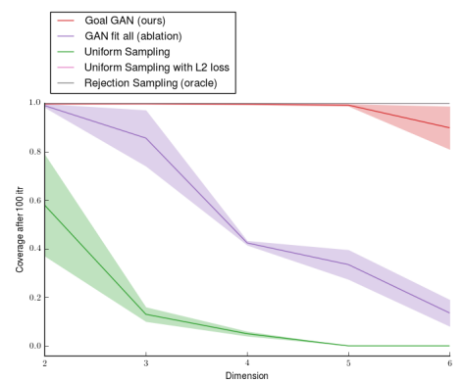
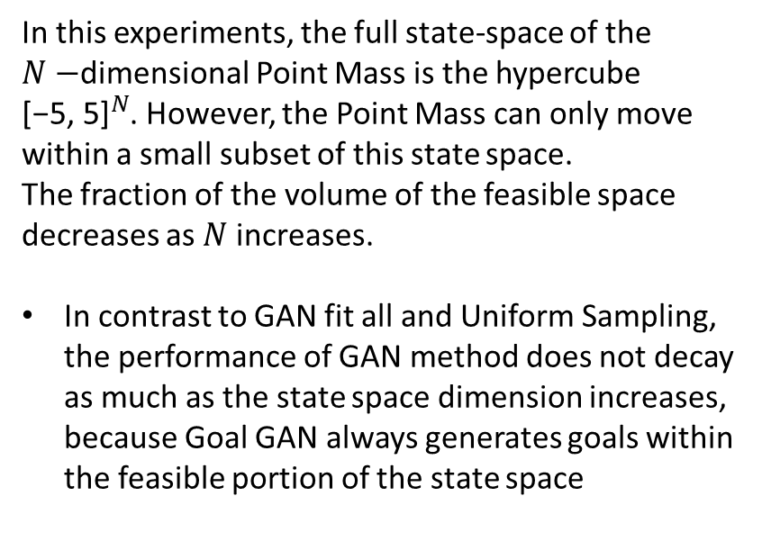
Experiment on N-dimensional space
In this experiments, the full state-space of the $N−$dimensional Point Mass is the hypercube ${\text{[−5, 5]}}^{N}$. However, the Point Mass can only move within a small subset of this state space.
The fraction of the volume of the feasible space decreases as $N$ increases.
In contrast to GAN fit all and Uniform Sampling, the performance of GAN method does not decay as much as the state space dimension increases, because Goal GAN always generates goals within the feasible portion of the state space

